Slide 1
Web Development 3
Introduction to PHP - 1
Ashley Cahill
ashley.cahill@tus.ie

Slide 2

Moodle
https://moodle.midlands.tus.ie/course/view.php?id=13541

Slide 3
Pop Quiz
www.vevox.com
Session ID: 148-540-408

Slide 4
Installations
XAMPP
NetBeans

Slide 5
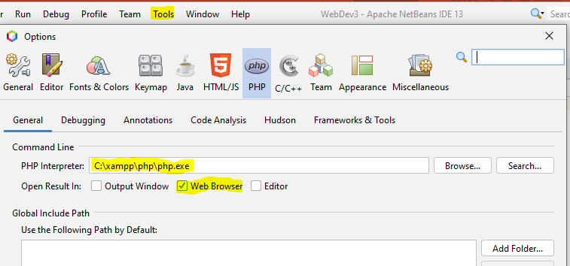
Configurations
XAMPP
Run the Apache service
The directory “C:\XAMPP\HTDOCS” is the “localhost” of your local web server
Files will be placed in this folder. Accessed in the browser via “localhost/example1.php
NetBeans

Slide 6
Learning Outcomes
Understand the history of PHP.
Describe PHP data types, variables and constants.
Compare the GET and POST HttpRequests.
Describe expressions, operators and functions.
Review PHP Documentation.

Slide 7
History of PHP
1994 – Rasmus Lerdorf created CGI scripts to track website traffic.
1995 – Scripts released as PHP Tools version 1.0
Along with website traffic, scripts could password protect pages
Also create forms
PHP was originally called Personal Home Page

Slide 8
History of PHP (contd.)
1996 – PHP/FI 2.0 released.
PHP Forms Interpreter.
Includes Conditional Statements and Database Access.
PHP now recognised as a Scripting Language.

Slide 9
History of PHP (contd.)
1998 – PHP 3.0 released.
Worked alongside Zeev Suraski and Andi Gutmans.
Included a rewrite of Parsing engine.
Support for all major O/S and additional Database support.
Renamed to PHP Hypertext Preprocessor.

Slide 10
History of PHP (contd.)
2000 – PHP 4.0 released.
Included a rewrite of the core engine.
Core engine renamed ZEND engine.
Minor releases between 2000 and 2004.

Slide 11
History of PHP (contd.)
2004 – PHP 5.0 released.
Update to ZEND engine 2.0.
Minor version 5.5 released with support for 64-bit build
PHP 6 – Issue with UNICODE. Not enough Dev Support
Non-UNICODE featured back ported to PHP 5

Slide 12
History of PHP (contd.)
2007 – PHP 7.0 released.
Update to ZEND engine 3.0.
Just In Time Compilation

Slide 13
PHP Overview
PHP is a recursive acronym for "PHP: Hypertext Preprocessor".
PHP is a general-purpose scripting language geared toward web development.
Server side scripting language that is embedded in HTML.
It is integrated with a number of popular databases, including MySQL, PostgreSQL, Oracle and Microsoft SQL Server.

Slide 14
PHP Overview (contd.)
PHP supports a large number of major protocols such as POP3, IMAP, and LDAP.
PHP Syntax is C-Like.
Can be used for developing websites and also command line scripting language – similar to Python/Perl.
PHP is forgiving: PHP language tries to be as forgiving as possible.
Scripts can continue running on minor faults.

Slide 15
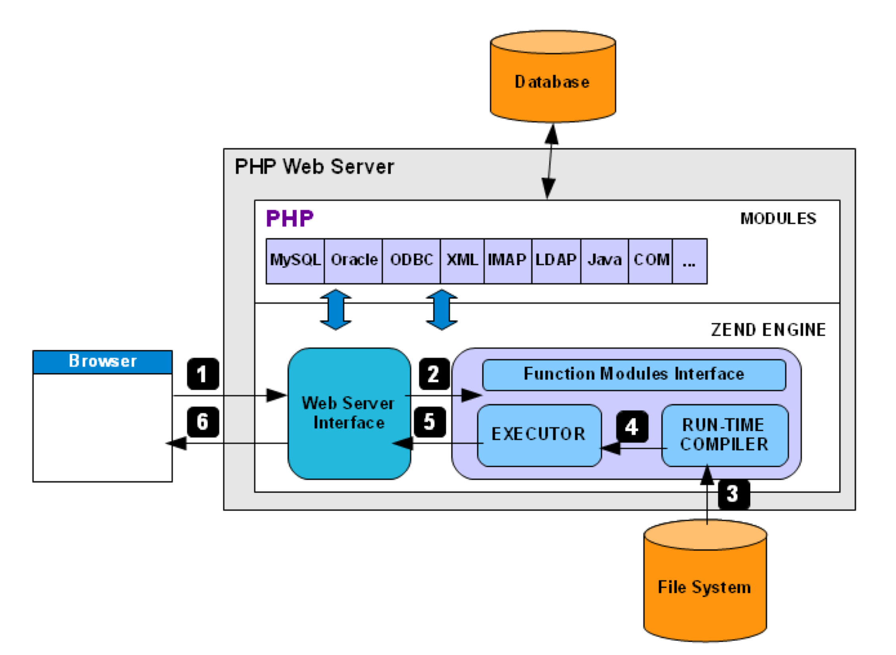
PHP Overview (contd.)
Client Request.
Web server forward to PHP Engine.
Read PHP script from file system, compile and send to executor.
Executor runs the compile code.
Resulting HTML output sent to Web Server Interface.
Response sent back to client.

Slide 16
Escaping To PHP
PHP is embedded into HTML
Where does the HTML stop and PHP start?
“Escaping To PHP” is how the PHP Parser differentiates PHP code from other elements in the web page.
Four ways to “Escape”

Slide 17
Escaping To PHP – Canonical Tags
Canonical PHP tags (The most universally effective PHP tag style)
<?php … ... ?>
If you use this style, you can be positive that your tags will always be correctly interpreted.

Slide 18
Escaping To PHP – Short Tags
Short-open (SGML-style) tags
<? … …
?>
Short tags are the shortest option.
Configuration may be needed

Slide 19
Escaping To PHP – ASP Style Tags
ASP-style tags - mimic the tags used by Active Server Pages to delineate code blocks.
<% ... %>
To use ASP-style tags, you need to set the configuration option in your php.ini file.

Slide 20
Escaping To PHP – HTML Script Tags
HTML script tags
<script language = "PHP">...</script>

Slide 21
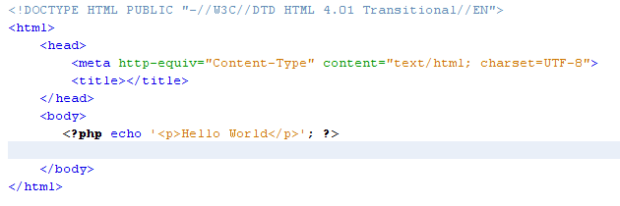

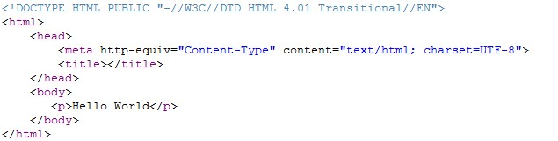
Escaping To PHP – Hello World

Slide 22
PHP Syntax
Syntax Rules
PHP files have a .php extension.
PHP statements end with a semicolon.
PHP is case sensitive.
PHP ignores extra whitespace in statements.

Slide 23
PHP Syntax (contd.)
Syntax Rules continued
PHP can be run from the command prompt
c:\xampp\php\php.exe –a
Will open an interactive php shell
c:\xampp\php\php.exe myphpfile.php
Will evaluate the PHP script – NB args can be passed in but not for $GET, $POST etc.)

Slide 24
Echo Statement
The syntax for the echo statement
echo string_expression;
How to use an echo statement within HTML
<p>Name: <?php echo $name; ?></p>
How to use an echo statement to output HTML tags and data
<?php echo '<p>Name: ' . $name . '</p>’; ?>

Slide 25
Lab Work
PHP Syntax
Echo
Write PHP file to “echo” out a string using variations of syntax.

Slide 26
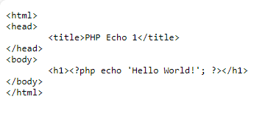
Lab Work
1

Slide 27
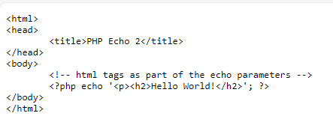
Lab Work
2

Slide 28
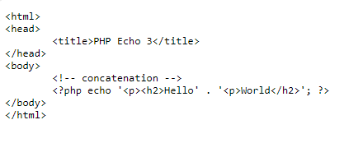
Lab Work
3

Slide 29
PHP Variables
Variable : An abstract storage location paired with an associated symbolic name, which contains some known or unknown quantity of information referred to as a value.
A value that can change, depending on conditions or on information passed to the program.

Slide 30
PHP Variable Names
Always begin with $
Case-sensitive.
$thisvariable is not the same as $ThisVariable is not the same as $THISVARIABLE
Variable names can contain letters, numbers, and underscores.
Variable names can’t contain special characters.
Variable names can’t begin with a digit or two underscores.

Slide 31
PHP Variable Names (contd.)
Variable names can’t use names that are reserved by PHP such as the variable named $this
$this is reserved for use with objects.

Slide 32
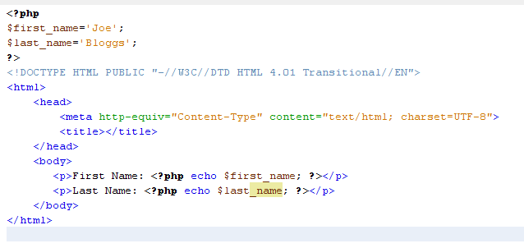
PHP Variable in HTML
PHP Variable Declarations
Embedded PHP in HTML

Slide 33
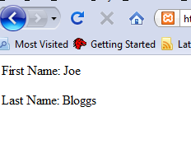
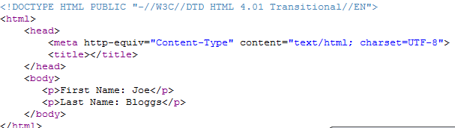
PHP Variable in HTML
Resulting Web Page
Generated Source

Slide 34
PHP Predefined Variable
Superglobals — Built-in variables that are always available in all scopes
$GLOBALS — References all variables available in global scope
$_SERVER — Server and execution environment information
$_GET — HTTP GET variables
$_POST — HTTP POST variables
$_FILES — HTTP File Upload variables
$_REQUEST — HTTP Request variables

Slide 35
PHP Predefined Variable (contd.)
$_SESSION — Session variables
$_ENV — Environment variables
$_COOKIE — HTTP Cookies
$php_errormsg — The previous error message
$http_response_header — HTTP response headers
$argc — The number of arguments passed to script
$argv — Array of arguments passed to script

Slide 36
PHP Data Types
String
Integer
Float (floating point numbers - also called Double)
Boolean
Array
Object
NULL
Resource

Slide 37
PHP Data Types
String
A string is a sequence of characters, like "Hello world!".
A string can be any text inside quotes. You can use single or double quote
Integer
Non-decimal (whole) number between -2,147,483,648 and 2,147,483,647.
Float
Numeric values with decimal digits

Slide 38
PHP Data Types
Boolean
2 possible states; TRUE or FALSE
Array
Stores multiple values in one single variable.
Object
Classes and objects are the two main aspects of object-oriented programming.
A class is a template for objects, and an object is an instance of a class

Slide 39
PHP Data Types
NULL
Special data type which can have only one value: NULL
Resource
Special resource type is not an actual data type. It is the storing of a reference to functions and resources external to PHP. (Beyond scope of this course)

Slide 40
PHP Variable Assignment
Using the assignment operator (=) as you declare a variable and give it a value.
$count = 10; // an integer literal
$list_price = 9.50; // a double literal
$first_name = 'Bob’; // a string literal
$first_name = "Bob"; // a string literal
$is_valid = false; // a Boolean literal

Slide 41
PHP Variable Assignment
Using the assignment operator (=) as you declare a variable and give it a value.
$product_count = $count; // $product_count is 10
$price = $list_price; // $price is 9.50;
$name = $first_name; // $name is "Bob“
$is_new = $is_valid; // $is_new is FALSE

Slide 42
PHP Constant
Use the “define” keyword to declare a Constant
define('MAX_QTY', 100); // interger constant
define('PI', 3.14159265); // float constant
define('MALE', 'm’); // string constant

Slide 43
String Expressions
How assign string expressions
Use single quotes to improve PHP efficiency
$first_name = ‘Bob’; $last_name = ‘Roberts’;
Assign NULL values to empty Strings
$address = ‘’; //an empty string $address = NULL; //a NULL value

Slide 44
String Expressions
Use double quotes for variable substitution
$name = “Name: $first_name“; //Name: Bob $name = “$first_name $last_name “ // Bob Roberts
Mix single and double quotes for special purposes
$last_name = "O'Brien"; // O’Brien
$line = 'She said, "Hi.“’; // She said, “Hi.”

Slide 45
String Concatenation
How to use the concatenation operator for simple joins
$first_name = ‘Bob’; $last_name = ‘Roberts’; $name= ‘Name: ‘ . $first_name //Name: Bob $name = $first_name . ‘ ‘ . $last_name // Bob Roberts

Slide 46
String Concatenation
How to join a number to a string
$price = 19.99;
$price_string= ‘Price: ‘ . $price //Price: 19.99

Slide 47
Lab Work
Variables
Write PHP files to show examples of variable assignment.

Slide 48
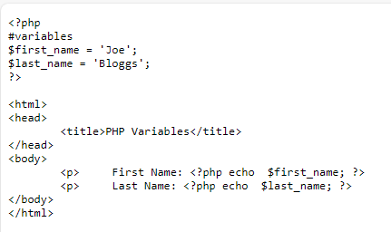
Lab Work
1

Slide 49
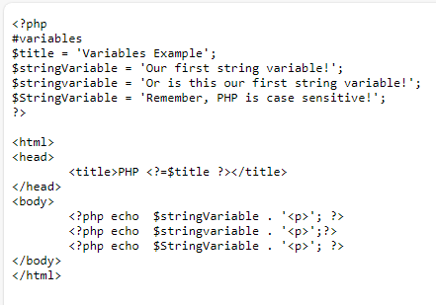
Lab Work
2

Slide 50
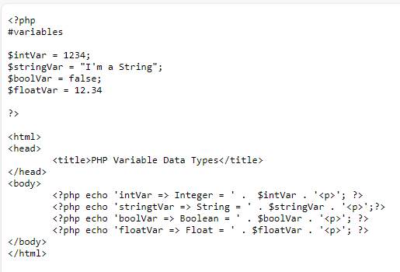
Lab Work
3

